Slide 1

Testing the winds, using personal power, tacking when unsure, and keeping your team on track with PAMED
Janet Thompson
PAMED Membership Liaison

Slide 2
How Can PAMED Help?
What issue do you hear most often from providers?
What interactions do you wish were stronger?
If time or money was no object, how could
PAMED help you help the physicians you serve?

Slide 3
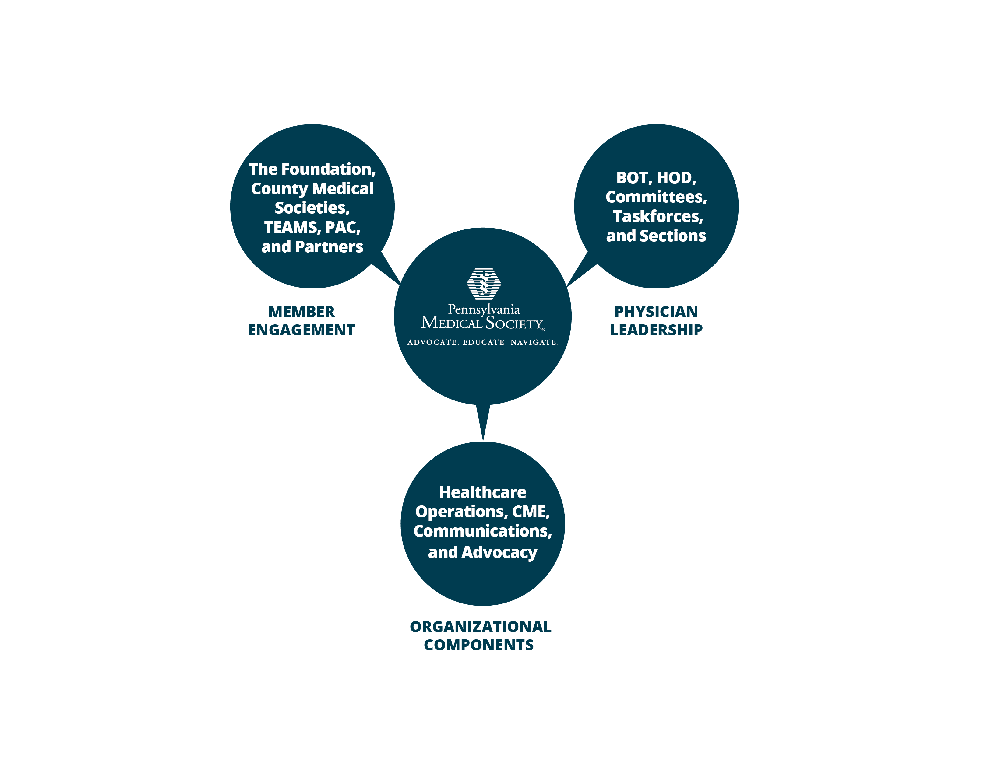
Who is PAMED?

Slide 4
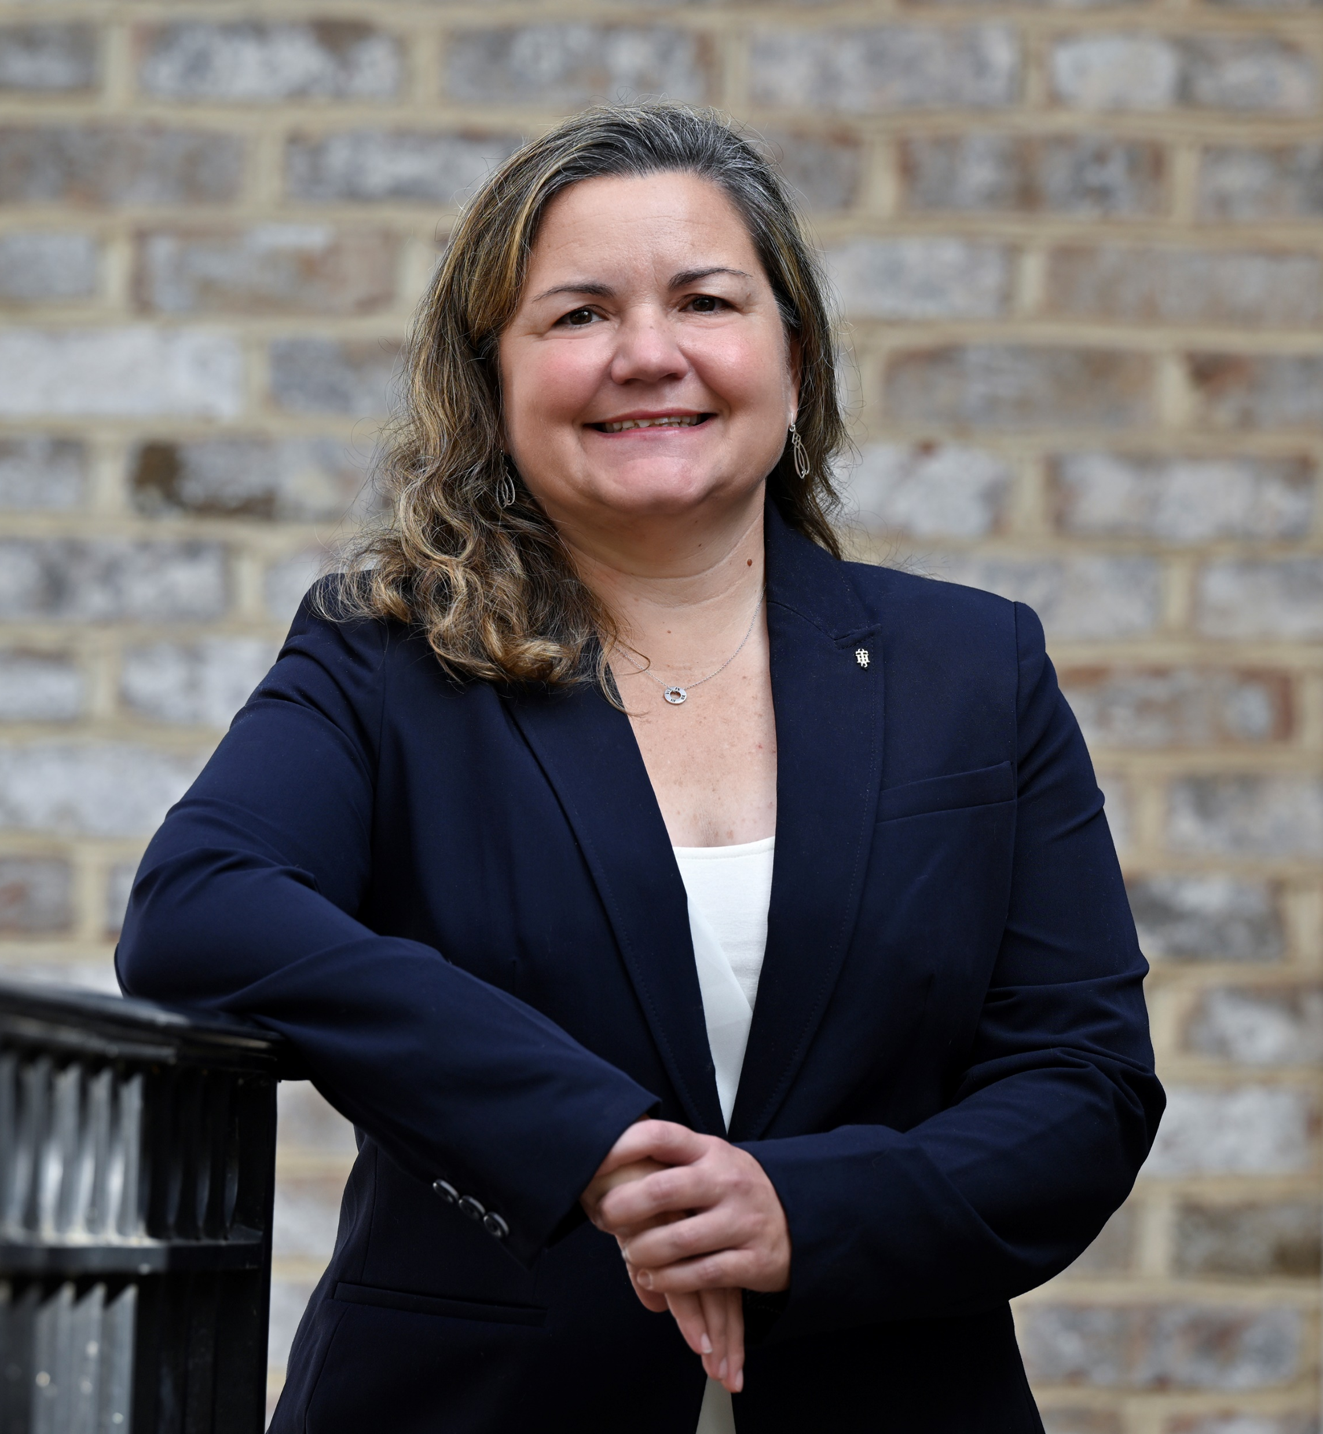
Do Your Physicians Need Help
Restoring Joy In Their Practice?
Revitalizing Our Profession: Working to Restore
the Joy of Practicing Medicine
Kristen Sandel, MD,
FACEP, FAAEM
174th PAMED President

Slide 5
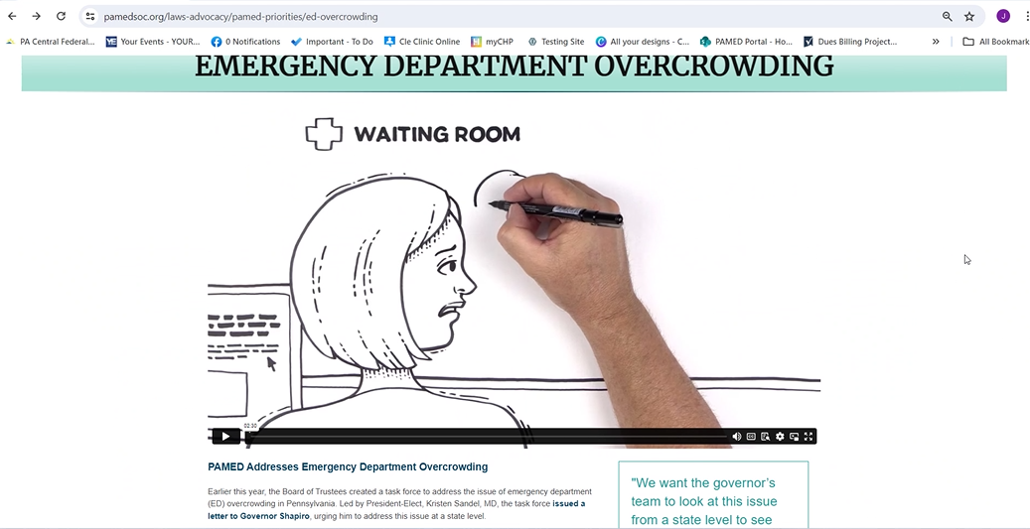
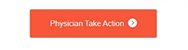
Is Your ED Overcrowded?
‘
to address the dire situation of emergency department
overcrowding across the Commonwealth

Slide 6
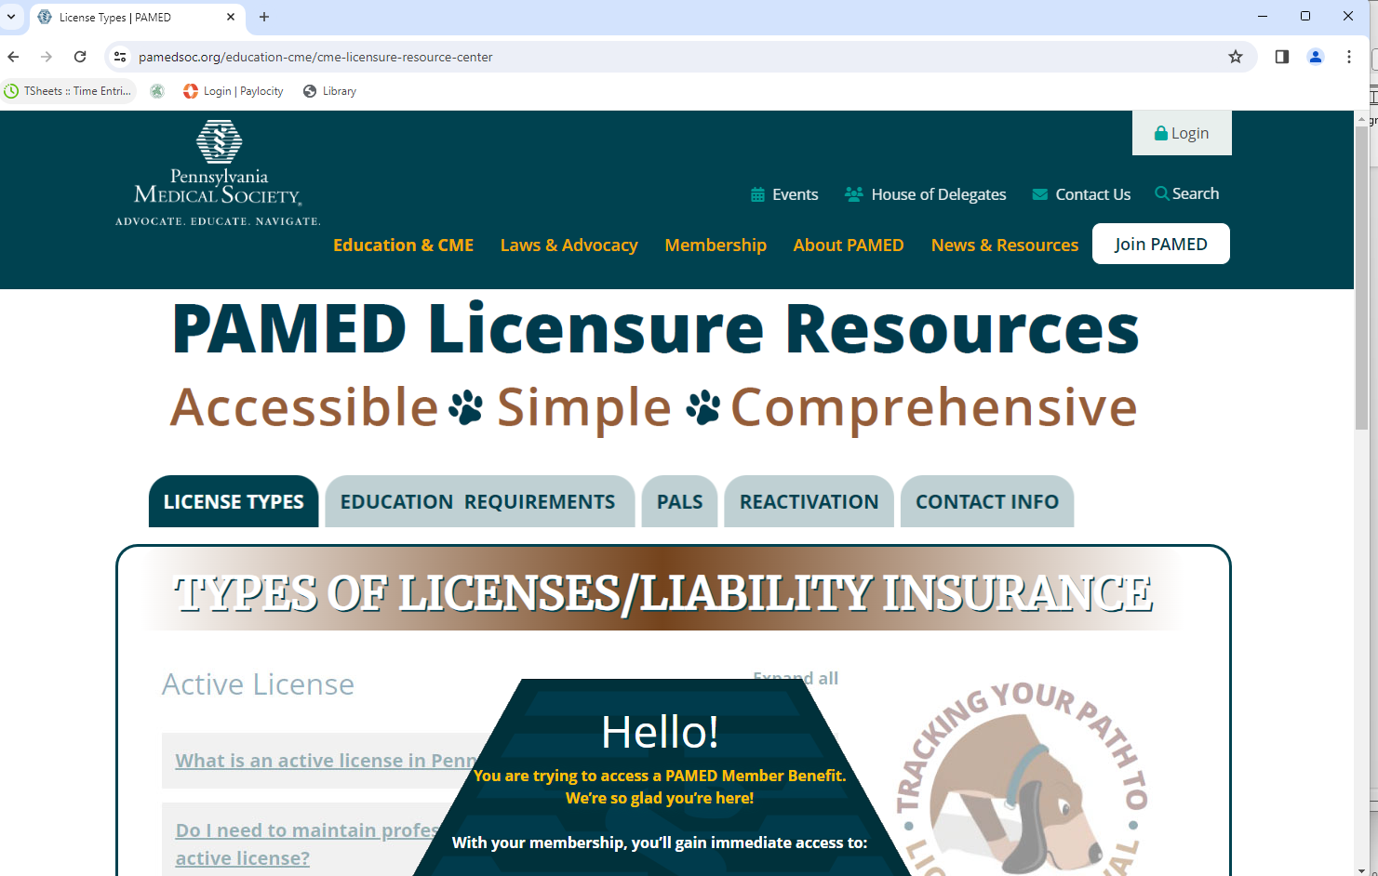
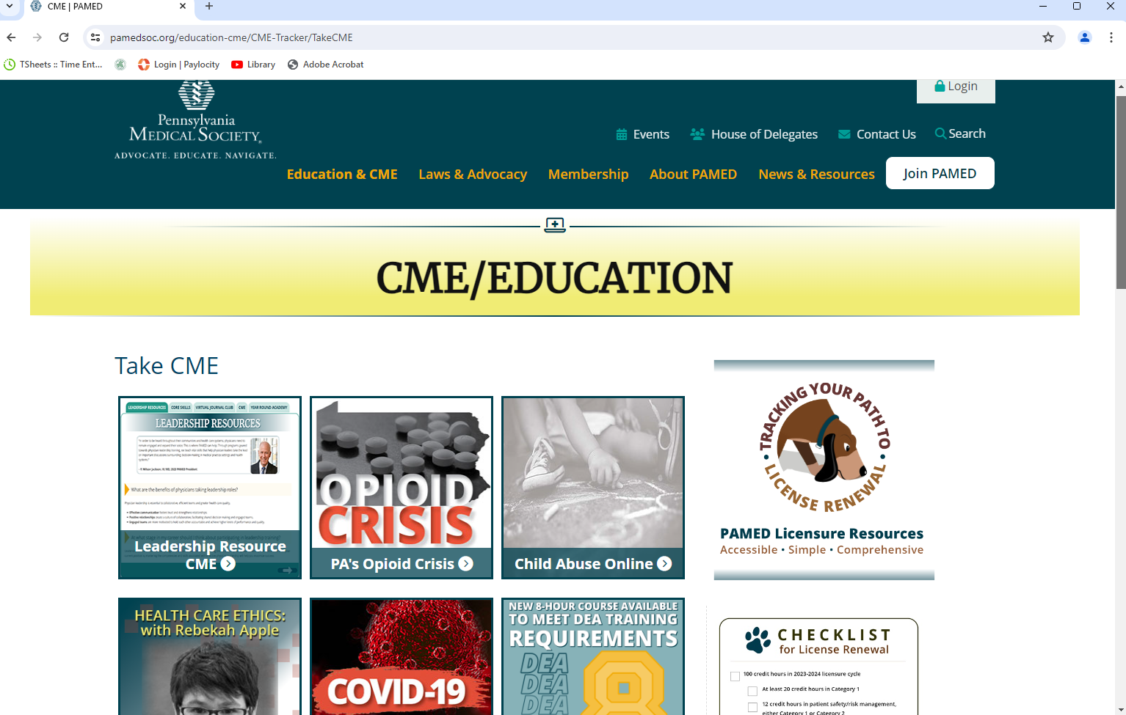
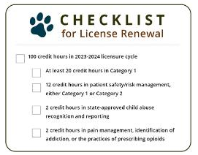
Do Your Physicians need
CME & Licensure Resources?
FREE

Slide 7
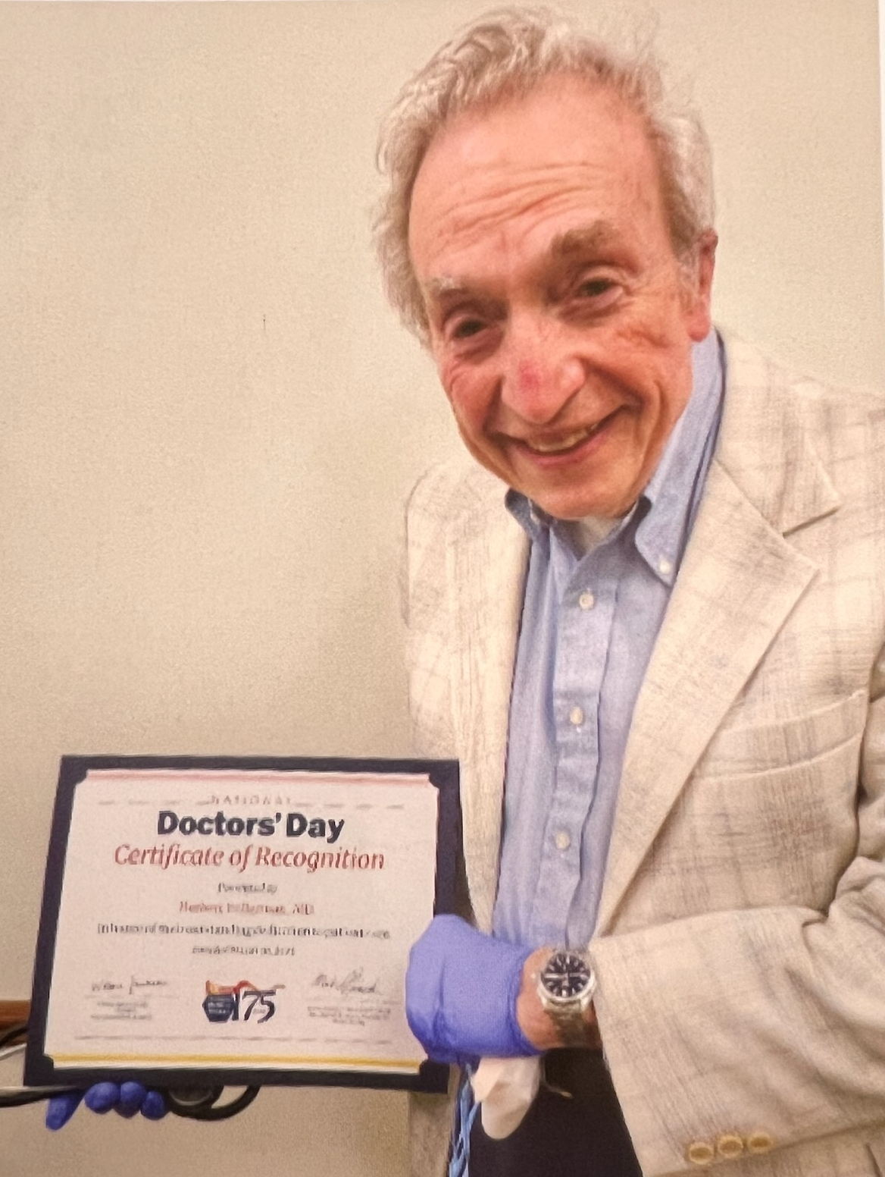
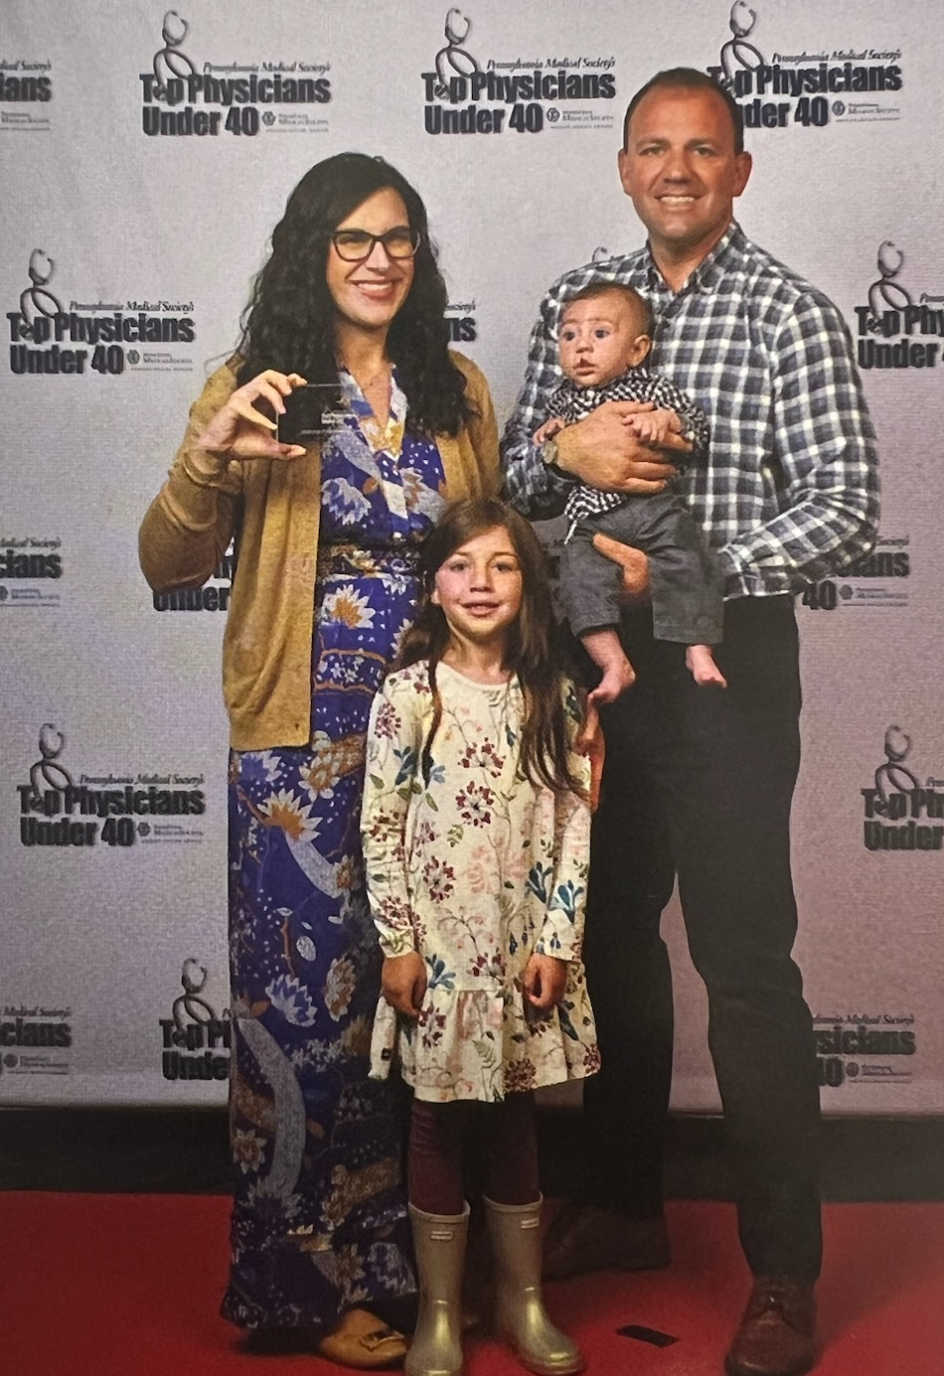
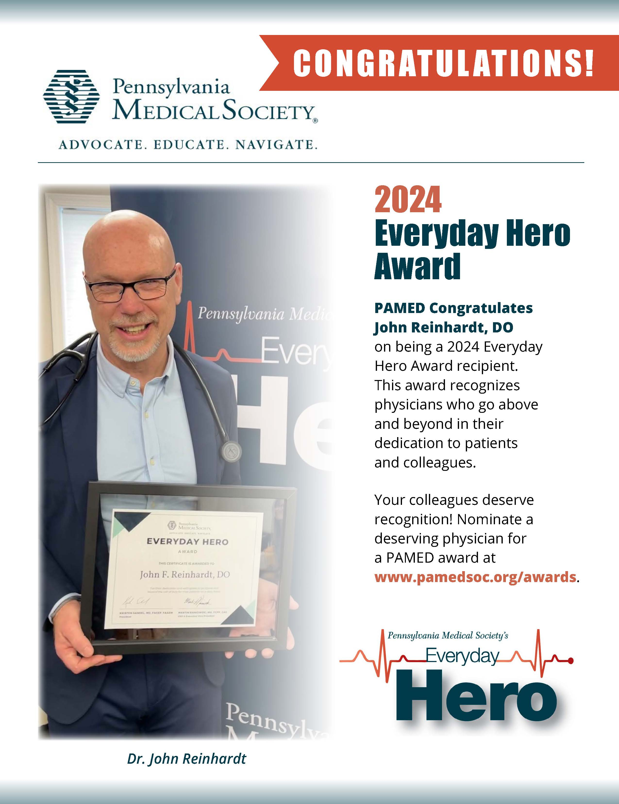
Do You Know A Physician
Who Should Be Recognized?

Slide 8

Did You Know PAMED Has
Corporate Partners?
https://www.pamedsoc.org/membership/partners

Slide 9

Do You Connect with PAMED?
      PAMED Website
      The Dose
      PAMED Knowledge Center
      Be Heard
      The Foundation of the Pennsylvania Medical Society

Slide 10

Do You Need Our Support?

Slide 11
How Can PAMED Help?
What issue do you hear most often from providers?
What interactions do you wish were stronger?
If time or money was no object, how could
PAMED help you help the physicians you serve?

Slide 12
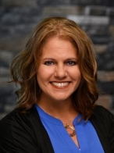
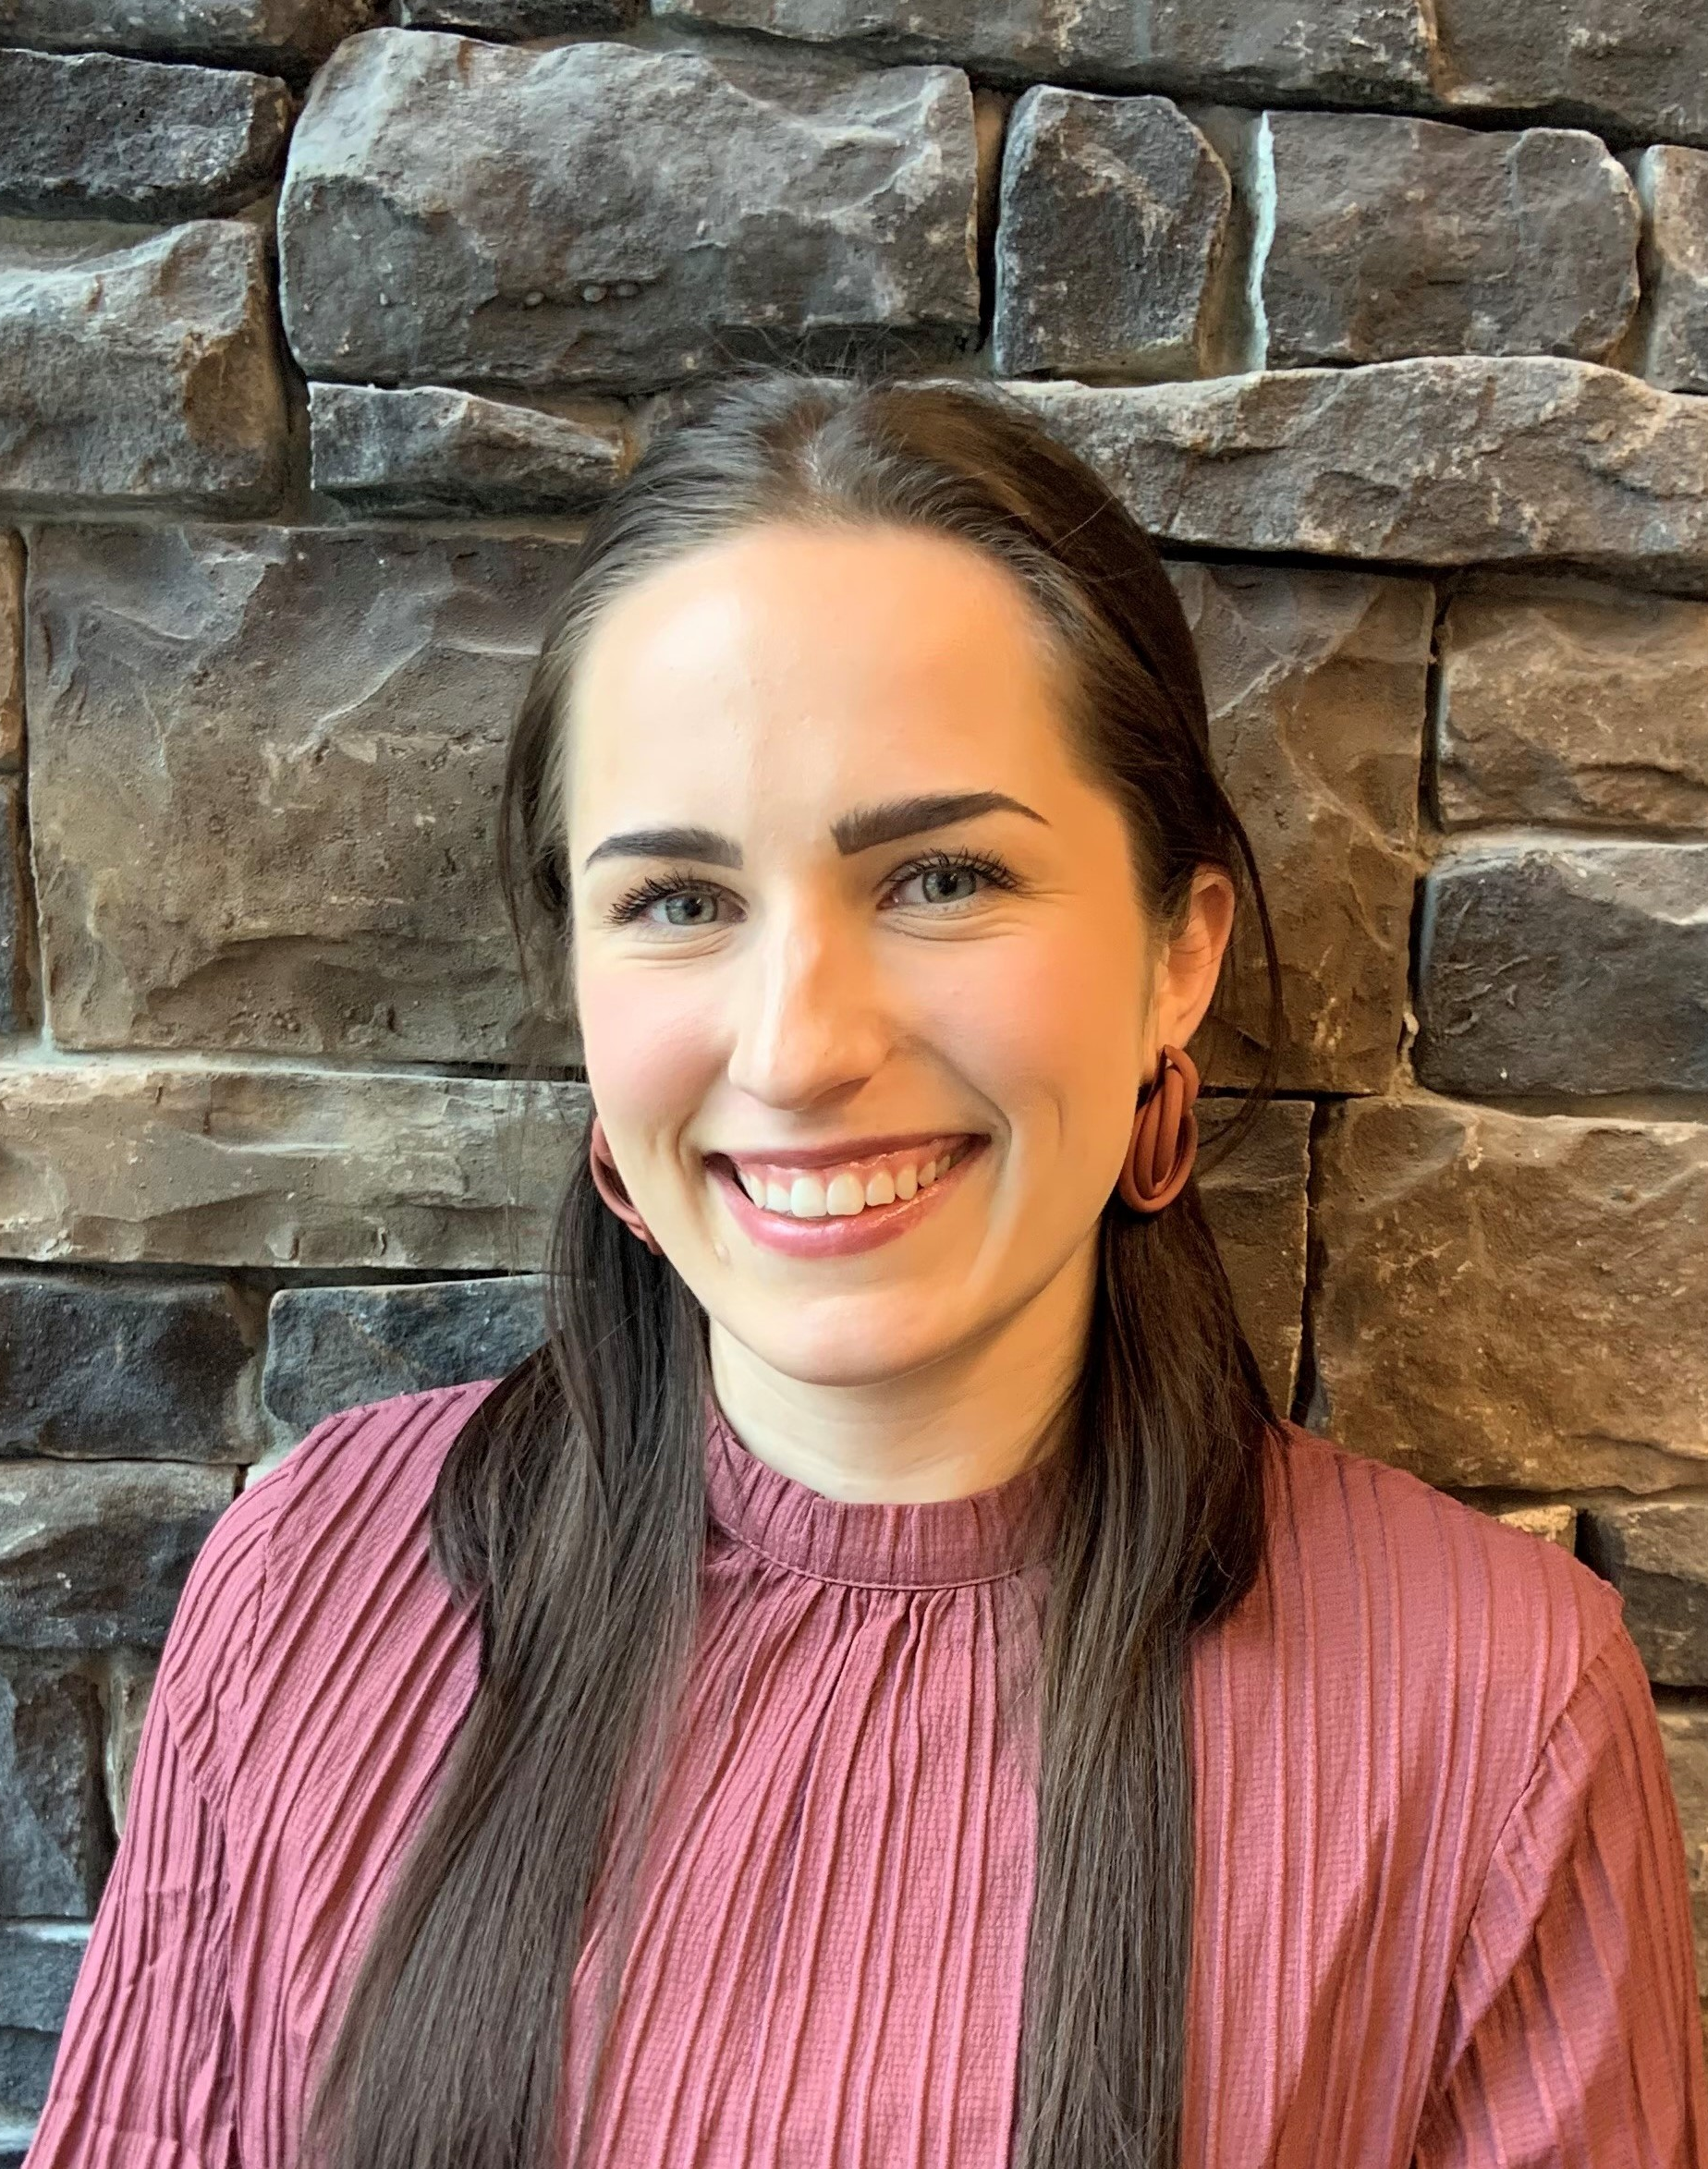
Do You Know Who To Call?
Contact us at
knowledgecenter@pamedsoc.org
Janet Thompson: jthompson@pamedsoc.org
(814) 397-0481
Avery Krot:
akrot@pamedsoc.org
(717) 909-2689

