Slide 1
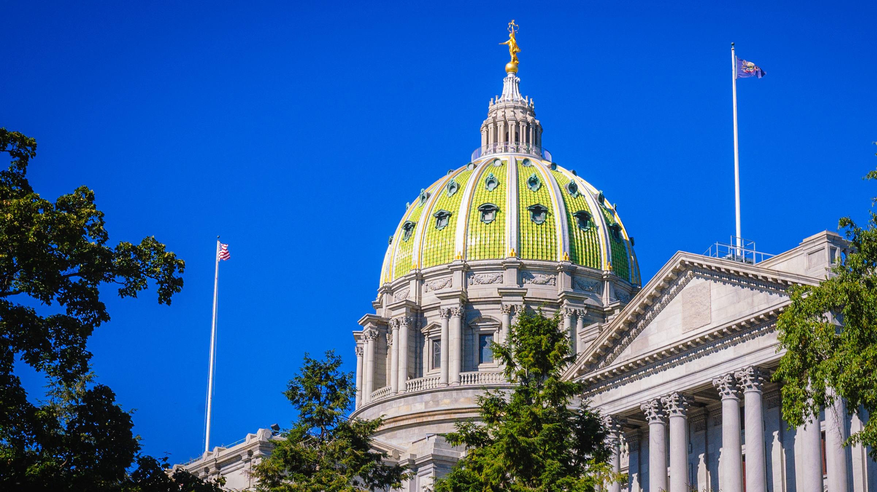

Department of State
Policy and Regulatory Updates
Andrew LaFratte
Deputy Policy Director
alafratte@pa.gov
717-775-4022

Slide 2

Agenda
Overview of DOS / Professional Licensure
Reducing Barriers & Creating Opportunities
Legislative and Regulatory Updates
Policy-Making Process
Regulatory Promulgation Process
Questions

Slide 3

Meet the presenter
Andrew LaFratte
Deputy Policy Director for the Pennsylvania Department of State.
Committed to eliminating obstacles to professional licensure and championing policies that enhance workforce development in the healthcare industry.
Joined the Department in 2019 and holds a Master's degree in Public Administration from the University of Pittsburgh

Slide 4

Professional Licensing
Nearly 25% of all Pennsylvania workers hold a license or certification to perform their job.
There are nearly 1 million licensed professionals practicing in PA
67% of PA’s licensee population are in
health care professions

Slide 5

Department of State
The Bureau of Professional and Occupational Affairs (BPOA) was established in 1963 as part of the Department of State (DOS) to provide administrative, logistical and legal support services to professional and occupational licensing boards and commissions.
Professional licensing protects the health, safety and welfare of the public from incompetent, fraudulent and unethical practitioners.
There are 29 licensing boards and commissions, each with its own statute governing its powers and functions.

Slide 6






BPOA
Major Functions
Approve Licensure Examinations
Review Applications
Certify Education Providers
Investigate Public Complaints
Promulgate Regulations
Administer Licenses

Slide 7
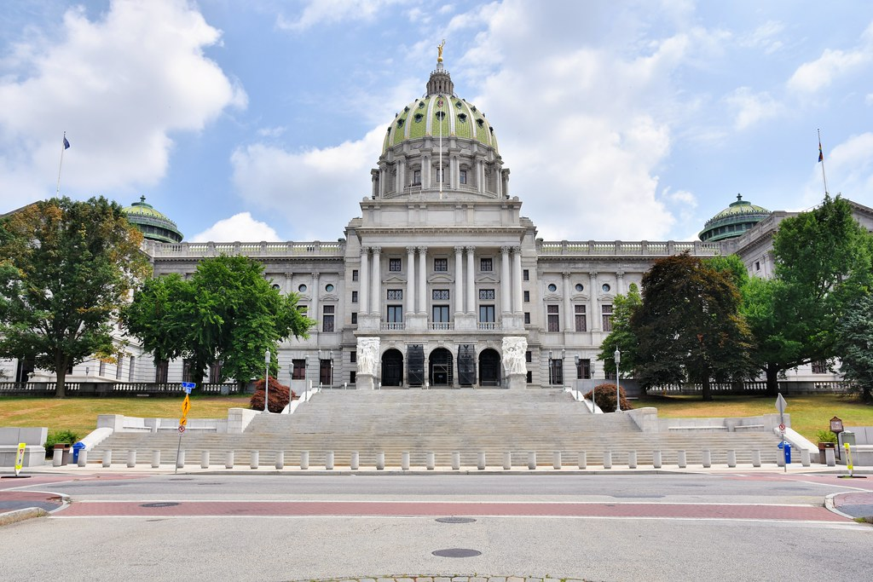


Reducing Barriers
&
Creating Opportunities

Slide 8
Reducing Barriers to Licensure
Increased Licensure Portability
Promoting Fairness for
Re-Entrants
Act 41 of 2019
Act 53 of 2020
These initiatives create new opportunities for professionals and contribute to the state's economic growth and diversity
Support for Servicemembers
Addressing Nursing Shortage
Act 35 of 2021
Partial Implementation of the Nurse Licensure Compact

Slide 9
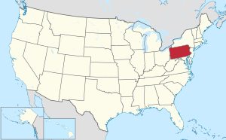

Act 41 of 2019
Allows out-of-state professional licensees to work in Pennsylvania, easing barriers to professional licensing and enhancing workforce mobility.
Licensing boards can now consider applicants licensed in another state, territory, or country
  IF that jurisdiction's licensing requirements are substantially equivalent to those required in Pennsylvania
Notes:
Impact on Professional Opportunities: The implementation of Act 41 creates new opportunities for professionals and contributes to the state's economic growth and diversity.
Reduces unnecessary barriers for new residents, veterans, military spouses, immigrants, and other individuals who wish to move to and work in Pennsylvania.

Slide 10


Act 53 of 2020
Brings about significant changes regarding the use of criminal history information in occupational licensing, promoting transparency, fairness, and inclusivity.
Requires boards to create a list of criminal offenses that could lead to license denial, suspension, or revocation, if deemed "directly related" to the occupation/profession.
Notes:
Addressing Barriers: The act aims to remove unnecessary barriers to licensure, enabling individuals with criminal histories to pursue meaningful careers.
Impact Assessment: The positive impact of Act 53 on the number of individuals with criminal histories obtaining licenses and gaining employment opportunities.

Slide 11


Act 53 of 2020
Allows for an "individualized assessment" of each license applicant using objective, detailed criteria that includes rehabilitation and public safety.
Provides a process for individuals who have criminal convictions to request a "preliminary determination" as to whether a particular conviction will be a bar to licensure.

Slide 12


Act 35 of 2021
Eases struggles for service members, veterans, and family members by removing barriers to professional licensing and employment.
The newly enacted law does the following:
provides expedited license application reviews for the military community
provides initial licensure fee waivers for Military Spouses
establishes the creation and utilization of a Military Occupational Crosswalk to help translate military experience into civilian licensure requirements.
Notes:
Enhancing Workforce Diversity: The act fosters a more inclusive workforce by recognizing and supporting the skills and experiences of military personnel.

Slide 13


Military Occupational Crosswalk
Purpose: Matches civilian career opportunities and requirements with veterans' military experience, aligning military skills, experience, credentials, and education with civilian opportunities.
Compares qualification details from nearly 300 military occupations to initial licensure requirements for related professions under DOS.
  70% of professions in healthcare related fields
https://www.dos.pa.gov/ProfessionalLicensing/Pages/Military-Occupational-Crosswalk-(Act35-2022).aspx
Notes:
Determines "substantially equivalent" military occupations for licensure and identifies any gaps in requirements.
https://www.dos.pa.gov/ProfessionalLicensing/Pages/Military-Occupational-Crosswalk-(Act35-2022).aspx

Slide 14

Interstate Compacts
An interstate compact is a legally binding agreement between two or more states.
Like a contract, a compact establishes a formal, legal relationship among states to address common problems or promote a common agenda
With a licensure compact, states establish uniform standards to lower barriers to multi-state practice while preserving a state’s practice act and initial licensure process.

Slide 15

Interstate Compacts
Nurse Licensure Compact
Interstate Medical Licensure Compact
Physical Therapy Compact
Psychology Compact

Slide 16

Partial Implementation of the Nurse Licensure Compact
Eases nursing shortage
Alleviates burden on overworked staff
Safer conditions for patients
Increase access to care
As of September 2023, RNs and LPNs who hold multistate licenses through the compact will be permitted to practice without obtaining a Pennsylvania license.

Slide 17

Interstate Compacts – Update
HB 2220 - which would allow the Nurse and Medical Licensure Compact to be fully enacted - has been voted out of the Professional Licensure Committee.
This legislation authorizes DOS to access the FBI’s fingerprint-based criminal history background check database for purposes of verifying licensing applicants’ criminal history - a precondition to fully participating in most interstate licensing compacts.
Notes:
DOJ recently issued its conditional approval of the substantive language contained in HB2200. Following passage of the legislation, the Department of State will continue to work with the Pennsylvania State Police and its federal partners to secure final FBI approval and fully implement the multistate licensure compacts.

Slide 18

Legislative and Regulatory Updates

Slide 19

Act 16 and Act 22 of 2022
Modernizing Processes for International Medical Professionals
and
Enriching Healthcare Landscape
Act 16 eliminates the previous requirement for international medical graduates to undergo an additional year of training, enabling them to apply for their medical license in the United States after completing two years of training.
Act 22 enables the State Board of Nursing to approve graduates of international nursing education programs to take the RN licensure exam in Pennsylvania if their education is deemed equivalent.
Notes:
Act 22 addresses the challenge faced by nursing graduates who relocate to Pennsylvania before obtaining licensure in their home country

Slide 20

Act 4 of 2024
Enhancing Access to Mental Health
Provides employment opportunities for new marriage and family therapists and professional counselors with master's or doctoral training, allowing them to gain supervised clinical experience
Establishes licensure categories for:
"Licensed Associate Marriage and Family Therapist"
"Licensed Associate Professional Counselor"

Slide 21

2024
Regulatory Focus
Child Abuse Reporting Training for Reporters
Licensure by Endorsement
Protecting Minors from Conversion Therapy
Registration of Naturopathic Doctors
Notes:
Licensure BY Endorsement – Act 41 – Competency Measures

Slide 22

2024 Legislative Tracker
SB 668 - creates Certified Medication Aides (CMAs) which are nurse aides who have worked one year in a long-term care nursing facility and have successfully completed a training program developed by DOH.
HB 1825 - allows CRNPs to practice independently by eliminating the requirement for collaborative agreements with physicians after three years of practice.
HB 1512 - allows for the provision of telemedicine and provider reimbursement for health care services provided through telemedicine.
Notes:
HB 1825 - allows an Advanced Practice Registered Nurse-Certified Nurse Practitioner (APRN-CNP), to practice independently by eliminating the requirement for collaborative agreements with physicians after three years of collaborated practice.
SB 668 - create Certified Medication Aides (CMAs) which are nurse aides who have worked one year in a long-term care nursing facility and have successfully completed a training program developed by the Department of Health (DOH).
HB 1512 - allow for the provision of telemedicine, which already is practiced by providers across the Commonwealth, and which is a convenient and effective way for providers to serve their patients. It will also result in provider reimbursement for medically necessary and appropriate health care services provided through telemedicine.

Slide 23

Policy-Making Process

Slide 24
Factors considered in Policy Analysis

Stakeholder Input
Legal Considerations
Outcomes & Equity
Cost-Benefit
Political Dynamics

Slide 25
Public Policy-Making Process

Agenda Setting
Adoption
Implementation
Evaluation
Adjustment
Formulation
Notes:
Agenda Setting
Identifying and prioritizing issues
Public opinion, political agendas, and stakeholder groups influence this process
Policy Formulation
Conduct research, gather data, analyze potential solutions, and draft proposals
Policy Adoption
Legislative Process – includes public hearings
Executive Action
Policy Implementation
Developing Regulations
Allocation Resources
Establishing administrative structures and coordinate efforts across agencies
Policy Evaluation
Measure outcomes; collect data; analyze results; determine if policy met goals
Policy Adjustment
Based on results, policymakers may choose to adjust, modify, or sunset a policy.
Throughout the policy-making process, various stakeholders, including government officials, legislators, advocacy groups, experts, and the public, contribute their perspectives and influence the direction and outcome of policies.
The process is iterative, dynamic, and subject to political, social, economic, and cultural factors that shape policy decisions and outcome

Slide 26

Regulatory Promulgation Process
Notes:
Each year licensing boards and commissions in the Bureau propose and adopt numerous regulations and amendments to current regulations.
Some regulations, such as those requiring fees for examinations and renewals, are required by statute.
In other instances, boards make changes to long-standing policy or wish to enact new standards of professional conduct for licensees.

Slide 27

How do boards adopt regulations?
Before drafting regulations, the agency undertakes extensive public outreach to those who will be most likely affected by the regulation.
Members of the regulated community are involved in the formulation of the language and development of standards
Each regulation contains a brief preamble that:
  Describes the public need for the regulation,
  What the regulation requires in legal and practical terms, and
  Who the regulation will likely affect.

Slide 28
Regulatory Promulgation Process

Board sends an “exposure draft” to interested parties for input.
Gov’s Off of Policy, Budget, and Counsel review.
Office of Attorney General reviews.
Legislature & IRRC comment on regulation.
Public has opportunity to file comments.
Proposed Regulation is published in the PA Bulletin.
If Legislature & IRRC find the reg. in the public interest, the board can adopt as a “final” reg.
Gov’s Off of Policy, Budget, and Counsel, legislature, public, IRRC, and Attorney Gen’s Office must review final reg.
Once approved, final regulation is published in the PA Bulletin.

Slide 29

Suggest a Legislative or Regulatory Change

Slide 30

How to suggest a policy or regulatory initiative
Contact your local representative and/or senator
Contact the Department of State
  Policy Office – Stakeholder Engagement
  Sunrise Review

Slide 31


Sunrise Review
A sunrise review explores whether there is a need for a particular regulation.
Anyone interested in proposing to regulate an unregulated profession, de-regulate a profession, or propose a new regulation or a change to an existing regulation can submit a sunrise application to the DOS Policy Office.
DOS will then perform a comprehensive analysis and submit a written report with recommendations to the legislature.
Notes:
to regulate a currently unregulated profession or occupation.
Please Contact the DOS Policy Office for more information.

Slide 32

Thank You!
Questions?
Andrew LaFratte
Deputy Policy Director
alafratte@pa.gov
717-775-4022
www.dos.pa.gov

