Slide 1

Credentialing Without Crying

Slide 2
Introduction/Agenda
      Collect Required Data
      Develop Credentialing Strategy
      Audit for Accuracy
      Submit Forms to Payers
      Regular Payer Follow-up
      Obtain Enrollment Number

Slide 3

Collecting Data From Physicians
Notes:
Initial send of forms to fill out for pre-application which will require board certifications, criminal records and record of any disciplinary action on the providers license or practice
Tickler for follow-up
Consider using time-sensitive or !! Emails
Separate Folder for EACH physician with delineations as to what the status is
sent
received back
sent to payer
followed up with payer
Problems
Received final from Payer
The more thorough and organized YOU are, the better this process will go

Slide 4

Developing Credentialing Strategy
Notes:
Onboarding Checklist
Checklist of what is needed from the physician
Checklist of what is being sent to the payer
Expectation management – this could take 90-150 days!!!

Slide 5

Auditing for Accuracy
Notes:
Before you send that packet off to the payer, be sure you have the following included:
Transcripts
DEA Registration
Board certification
Medical License
Professional and personal references
Explanation of any gaps in work history
Personal immunization record
Personal health history
CAQH enrollment
Hospital Affiliation
In addition, for a new provider you will also need:
You will need to provide an updated CAQH profile with a new practice affiliation. Also, make sure the provider’s driving license and DEA are updated with the new state if the affiliation is different from their previous one.
The group that will be adding the new provider will be required to supplement a list of payers that they are currently affiliated with. This will include Medicaid HMOs, worker’s compensation, Tricare, Medicare advantage, etc.
Update your practice’s CAQH profile and supply tax companies with your Tax ID.
You will be required to submit a new and updated malpractice policy and also update it in your CAQH profile.
You will be required to provide the practice’s primary billing type. This information will be listed on your application with Tax ID.
Mention Medicare’s PTAN that you plan to be included on. This information will be listed on the Medicare application of the new provider linked to your group

Slide 6

Following up with Payers
Notes:
Make sure you are using the payer’s preferred communication system
Ask for the status of any open credentialing packets so you only need to call once.

Slide 7

Obtaining Enrollment Number

Slide 8

Keeping Track of your Submissions

Slide 9

Policies
Process
PREVAIL!!

Slide 10

Feeling Better?
Any Questions?

Slide 11
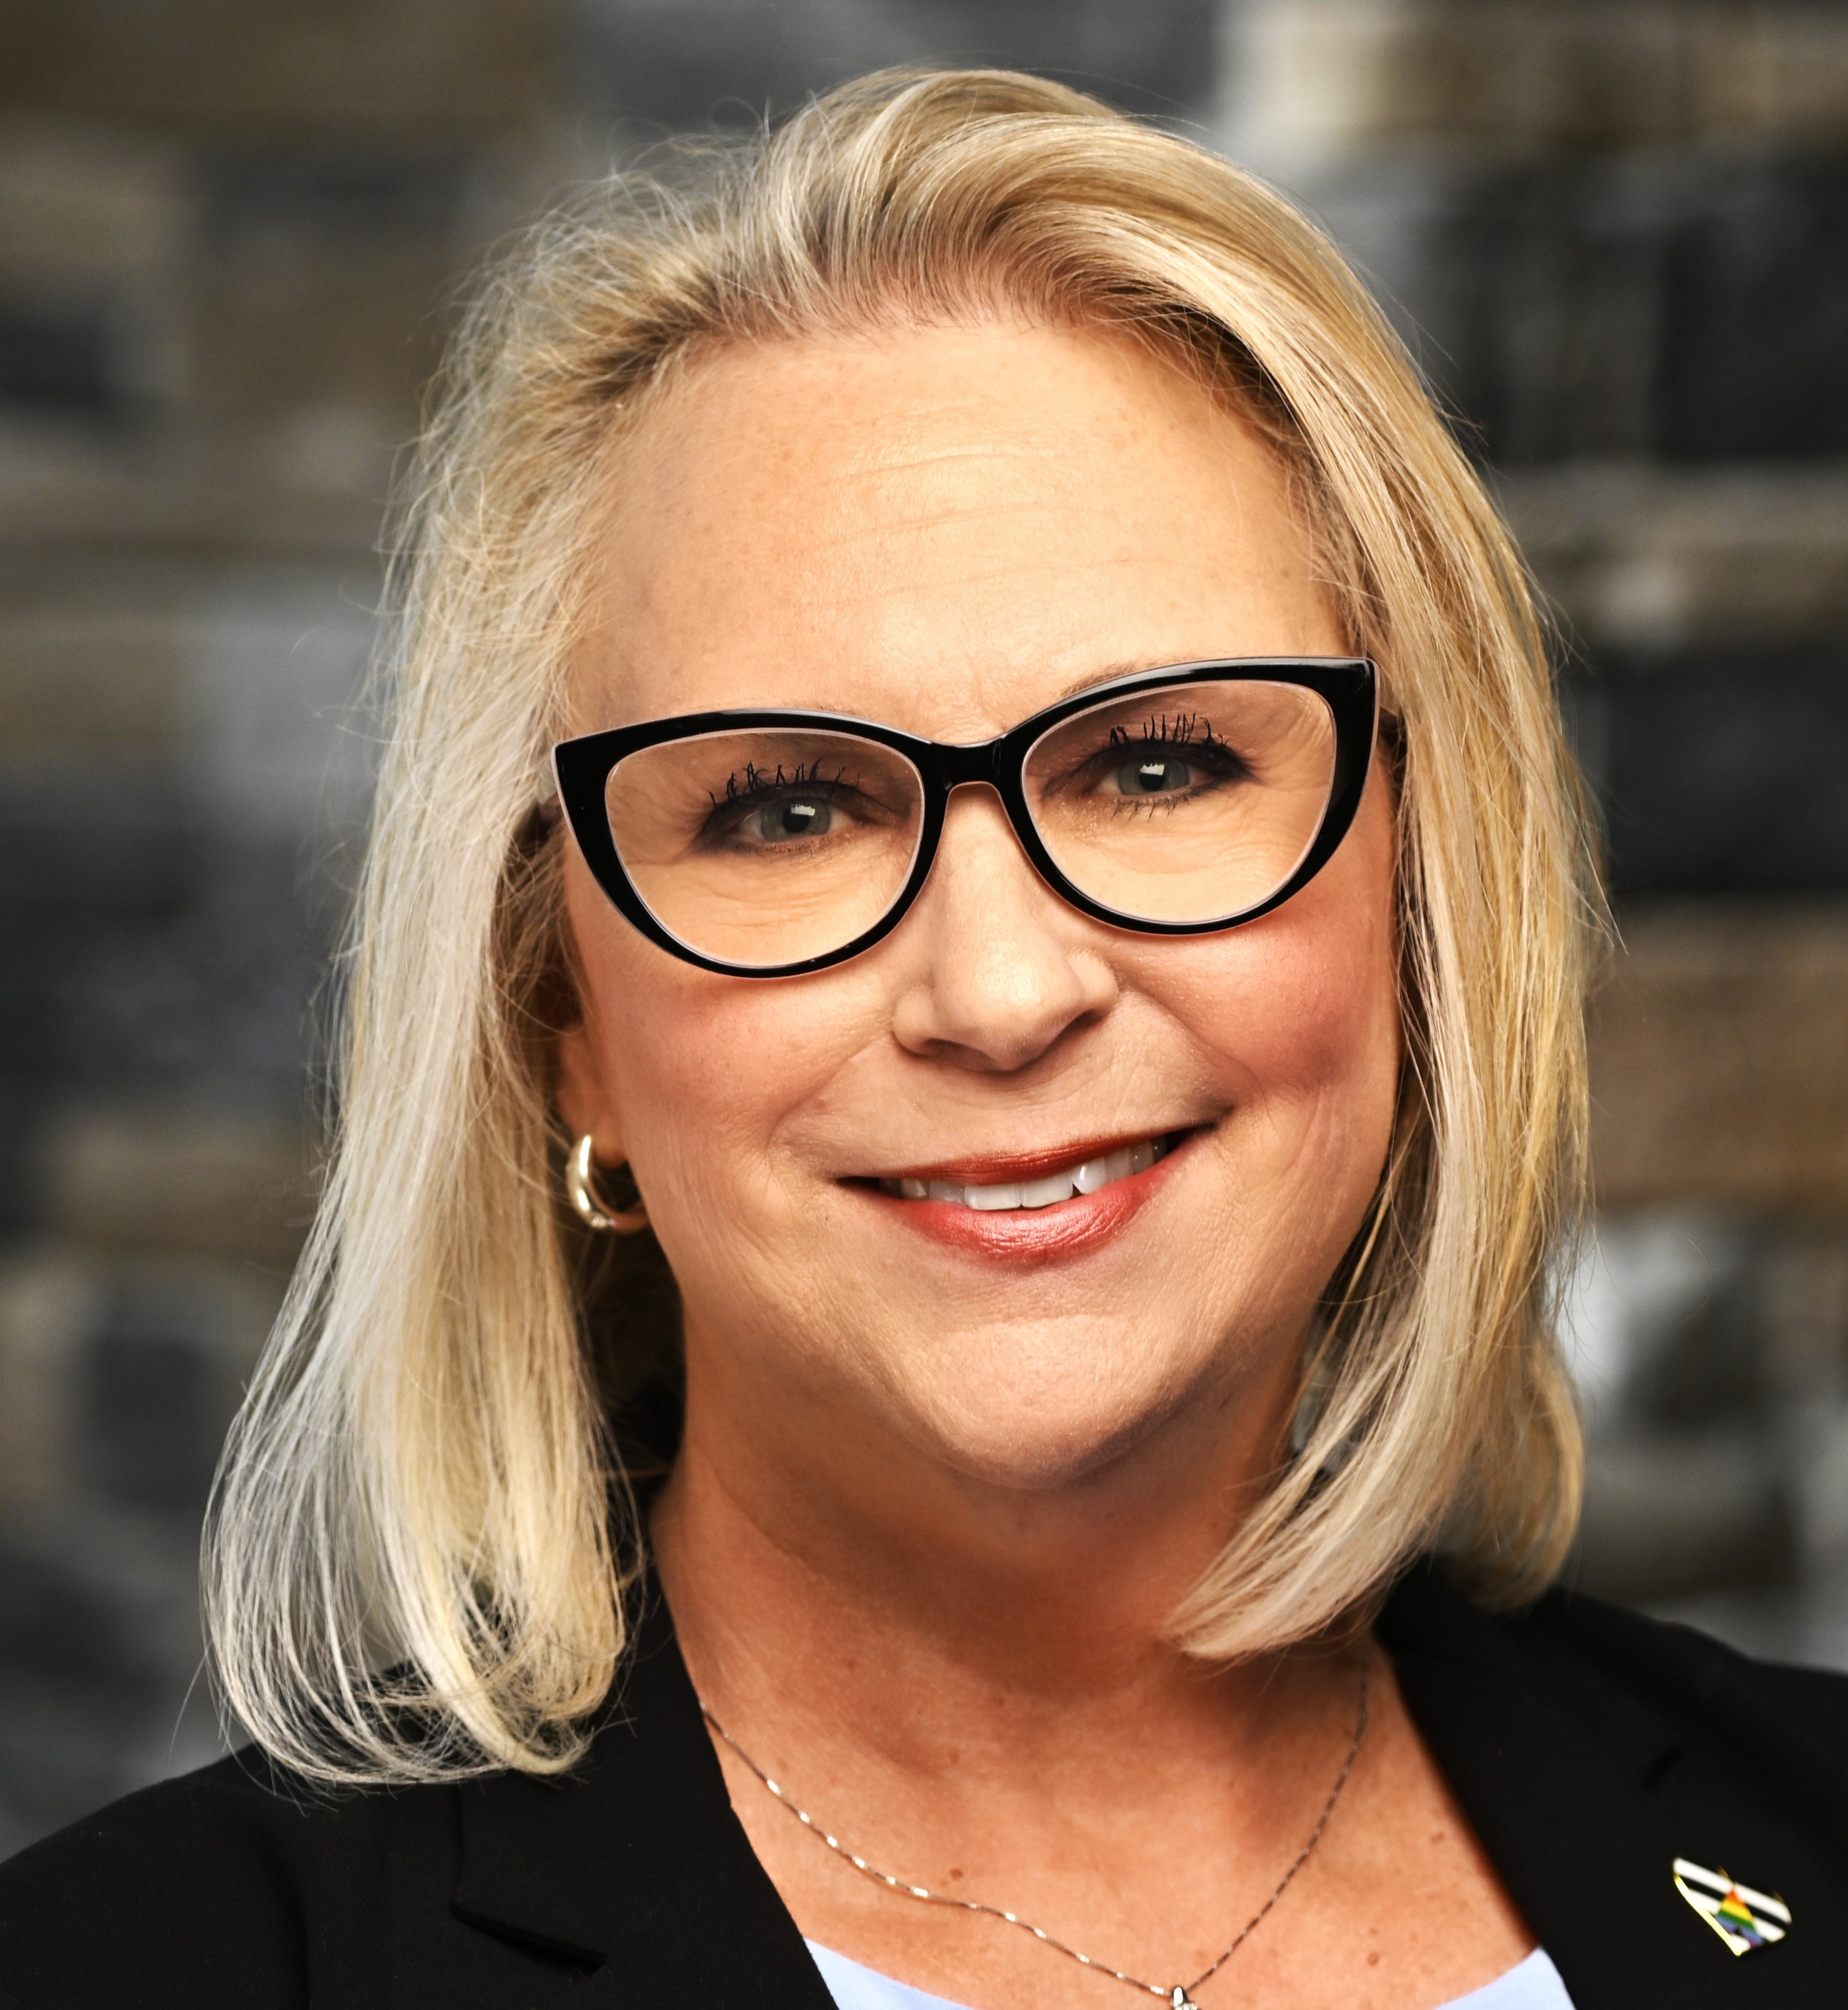
PAMED Healthcare Operations
Heather King
Director, Healthcare Operations
hking@pamedsoc.org

